Slide 1
Deep Neural Network

Slide 2

Deep Neural Network
Disclaimer and Acknowledgement
The content for these slides has been obtained from books and various other source on the Internet
I here by acknowledge all the contributors for their material and inputs.
I have provided source information wherever necessary
I have added and modified the content to suit the requirements of the course

Slide 3
Session Agenda
Optimization Algorithms
    Gradient Descent
    Stochastic Gradient Descent
    Mini batch Gradient Descent
    Gradient Descent with momentum
    ADAgrad
    RMSProp
    Adam

Slide 4
Optimization Algorithm
Optimization algorithms train deep learning models.
Optimization algorithms are the tools that allow
  continue updating model parameters
  to minimize the value of the loss function, as evaluated on the training set.
In optimization, a loss function is often referred to as the objective function of the optimization problem.
By tradition and convention most optimization algorithms are concerned with minimization.
The goal of optimization is to reduce the training error. The goal of deep learning is to reduce the generalization error, this requires reduction in overfitting also.

Slide 5
Why Optimization Algorithm?
Understanding the principles of different optimization algorithms and the role of their hyperparameters will enable us to tune the hyperparameters in a targeted manner to improve the performance of deep learning models

Slide 6
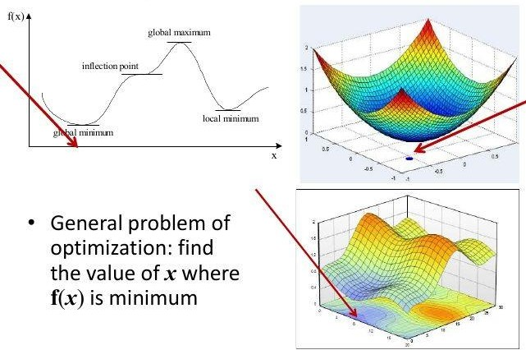
Optimization

Slide 7
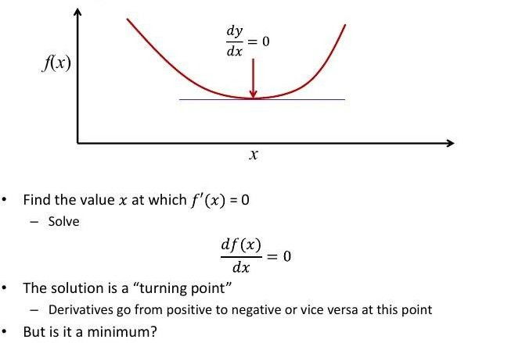
Finding Minimum of a Function

Slide 8
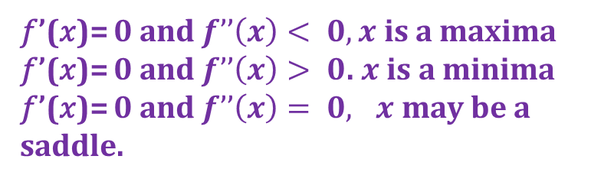
Derivatives and critical points
𝑓’(𝑥)= 0 at 𝑥
𝑓’(𝑥)= 0 just before 𝑥 𝑓’(𝑥)= 0 just after 𝑥
𝑥 may be a saddle
𝑓’(𝑥)= 0 at 𝑥,
𝑓’(𝑥)>0 just before 𝑥 𝑓’(𝑥)<0 just after 𝑥
𝑥 is a maxima
𝑓’(𝑥)= 0 at 𝑥
𝑓’(𝑥)< 0 just before 𝑥 𝑓’(𝑥)>0 just after 𝑥
𝑥 is a minima
𝑓’(𝑥)= 0 and $f’’\left(x\right)< 0,x$ is a maxima
𝑓’(𝑥)= 0 and $f’’\left(x\right)> 0$. $x$ is a minima
𝑓’(𝑥)= 0 and $f’’\left(x\right)= 0, x$ may be a saddle.

Slide 9
Reminder: The error surface for a linear neuron
The error surface lies in a space with a horizontal axis for each weight and one vertical axis for the error.
  For a linear neuron with a squared error, it is a quadratic bowl.
For multi-layer, non-linear nets the error surface is much more complicated.
  But locally, a piece of a quadratic bowl is usually a very good approximation.
  GD can be a good approximation
E
w1
w2

Slide 10
Gradient Descent
One-Dimensional Gradient Descent
In one-dimensional gradient descent, the algorithm adjusts a single parameter to minimize a function by following the negative direction of the gradient.
Multivariate Gradient Descent
For multivariate functions, gradient descent adjusts multiple parameters simultaneously by iteratively updating them in the direction of the negative gradient.

Slide 11



Gradient descent
Objective function is usually the average of the loss functions for each example in the training dataset.
    n= no of examples training dataset
    𝑓_{𝑖} (x) = loss function with respect to the training example of index 𝑖
    x = parameter vector
objective function :
gradient of the objective function at x :
Update rule
In vanilla GD, computational cost for each independent variable iteration is O(n) which grows linearly with n
Larger the training dataset is larger, higher the cost of GD for each iteration

Slide 12
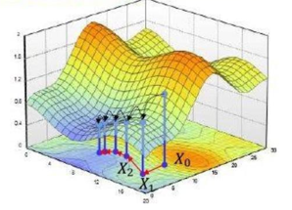
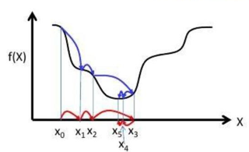
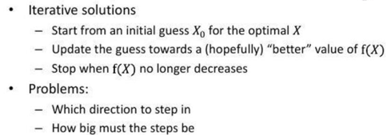
Gradient descent
Loss functions of most deep learning models are non-convex
Non-convex functions have multiple minima. Usually harder to optimize as compared to convex functions

Slide 13
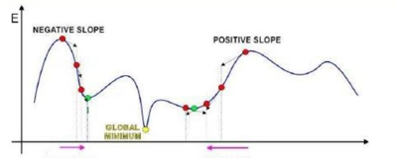
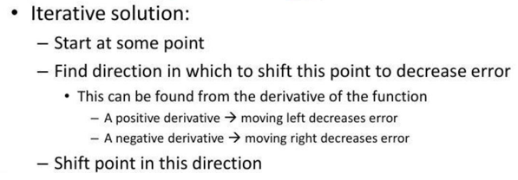
Gradient descent

Slide 14
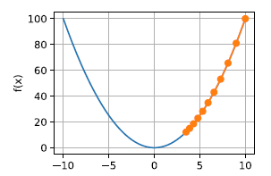
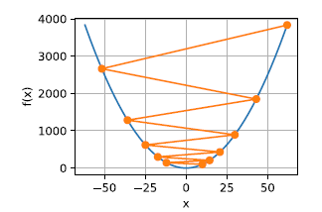
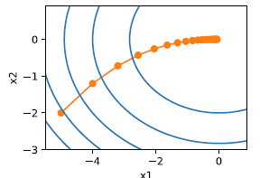
Learning rate
The role of the learning rate is to moderate the degree to which weights are changed at each step.
Learning rate η is set by the algorithm designer.
Optimal η
GD converges, a suitable η is often found only after multiple experiments
Slow Learning
If we pick η too small, we make little progress.
Oscillations
If we pick η too large, the solution oscillates and in the worst case it might diverge.

Slide 15
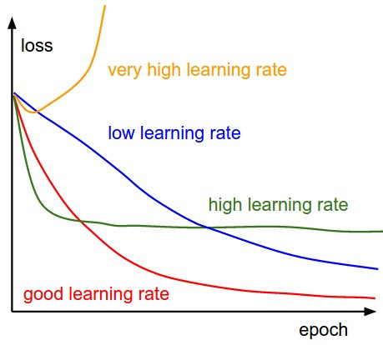
Learning rate

Slide 16
Local minima vs global minimum for DNN
Tweak the learning rate
  Gradually reduce the learning rate, then increase it and slowly reduce it, again, several times.
  Increasing the learning rate reduces the stability of the algorithm, but gives the algorithm the ability to jump out of a local optimum
Another takeaway
  Finding the global minimum is probably not the best as it would probably represent extreme overfitting on the training set.
  Empirical evidence shows that generalization performance is same for local minima solution and global minimum solution

Slide 17

Stochastic gradient descent
SGD reduces computational cost at each iteration
At each iteration of stochastic gradient descent, we uniformly sample an index 𝑖 ∈ {1, . . . , n} for data examples at random
compute the gradient to update x:
computational cost for each iteration drops from O(n) of the GD to the constant O(1), hence it is computationally efficient

Slide 18
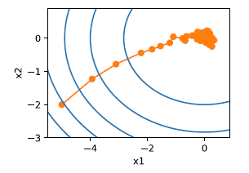
Stochastic gradient descent
It may diverge near minimum
This leaves us with the only alternative: change the learning rate η
However, if we pick this too small, we will not make any meaningful progress initially
On the other hand, if we pick it too large, we will not get a good solution
The only way to resolve these conflicting goals is to reduce the learning rate dynamically as optimization progresses

Slide 19

Dynamic learning rate
Replace η with time-dependent learning rate η(t)
  adds to the complexity of controlling convergence of an optimization algorithm.
Piecewise constant
  decrease the learning rate, e.g., whenever progress in optimization stalls.
  This is a common strategy for training deep networks.
Exponential decay
  Leads to premature stopping before the algorithm has converged.
Polynomial decay with α = 0.5

Slide 20
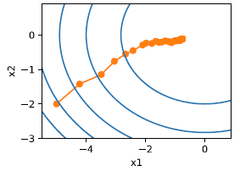
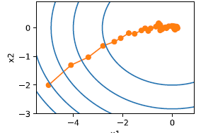
Dynamic learning rate
Variance in the parameters is significantly reduced. But,
The algorithm fails to converge at all.
Convergence gets better after only 50 steps.
Exponential decay
Polynomial decay

Slide 21

Mini batch GD
GD is not particularly data efficient
SGD is not particularly computationally efficient since CPUs and GPUs cannot exploit the full power of vectorization
Mini batch GD: read mini batches of data rather than single observations to update parameters
Weight update:
Pick a mini batch (which is hyper parameter) that is large enough to offer good computational efficiency while still fitting into the memory of a GPU.
For small training sets (e.g., <2000), use GD
For larger sets, sizes between 64 to 512 (preferably powers of 2) are typical.

Slide 22
Steps for mini batch GD
Split the data into mini-batches, e.g., X⁽¹⁾ through X⁽¹⁰⁰⁰⁾, X⁽¹⁰⁰¹⁾ through X⁽²⁰⁰⁰⁾, and so on.
For each mini-batch, perform forward propagation using only the data in that mini-batch.
Compute the cost function for that mini-batch.
Implement backpropagation to compute gradients.
Update the weights and biases using the gradients.
  Enables progress in gradient descent even when only partially through the training set.
  With GD , cost should decrease every iteration.
  For mini-batch GD, cost might not decrease every iteration due to different training batches.
  Cost function J should generally trend downwards but may oscillate due to varying difficulty of mini-batches.

Slide 23
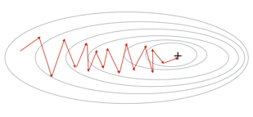
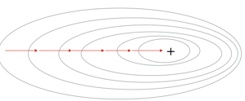
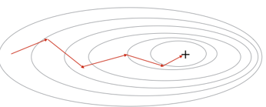
GD vs SGD vs Mini batch GD
Stochastic gradient descent
Noisy, oscillates around the minimum
but may not converge to it.
Gradient descent
Takes consistent steps toward minimum.
Mini batch gradient descent
Noisy, oscillates around the minimum but may not converge to it.

Slide 24
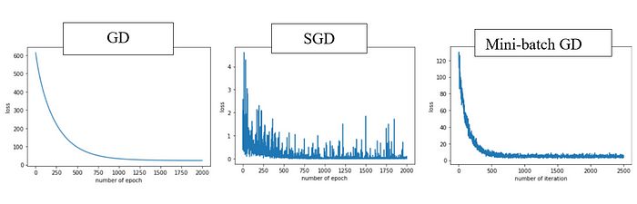
GD vs SGD vs Mini batch GD
GD is computationally heavy, converges to a “flat minima” but performs well on the test data.

Slide 25
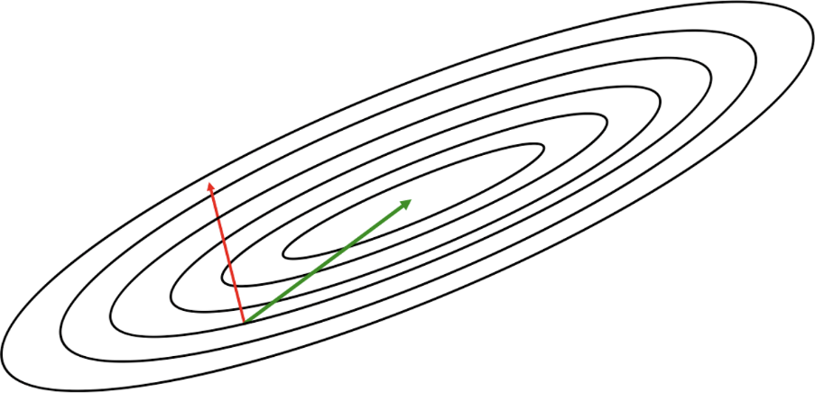
Drawback of gradient based methods
The most critical challenge to optimizing deep networks is finding the correct trajectory to move in.
Gradient isn’t usually a very good indicator of the good trajectory.
when the contours are perfectly circular , gradient always point in the direction of the local minimum.
However, if the contours are extremely elliptical (as is usually the case for the error surfaces of deep networks), the gradient can be as inaccurate as 90 degrees away from the correct direction!

Slide 26
Error surface of DNN
A critical point can only be a local minimum if it appears as a local minimum in every single one of the 𝑑 one-dimensional subspaces
As the dimensionality of our parameter space increases, local minima become exponentially more rare
As our function has more and more dimensions (i.e., we have more and more parameters in our model), saddle points are exponentially more likely than local minima

Slide 27
Exponentially Weighted Averages (EWA)
Technique used to calculate the moving average of a time series, where more recent data points are given higher weights, and older data points are given lower weights.
The weights decline exponentially as the data points get older, hence the name “exponentially weighted”
Applied in various optimization algorithms in deep learning, such as Gradient Descent with Momentum, RMSprop, and Adam
The EWA is calculated using the following formula:
V_{t} = β ∗ (V_{t}−1)+(1−β) ∗ NewSample
  V_{t} = weighted average at time t
  β = coefficient of momentum, parameter that determines weight given to previous values (between 0 and 1)
  NewSample is t= he new data point at time t

Slide 28
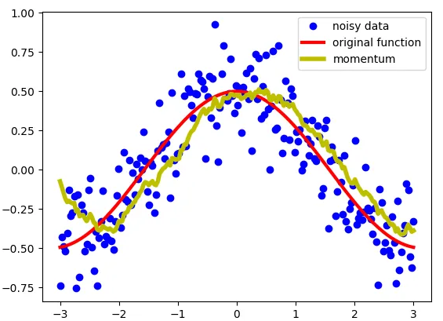
EWA

Slide 29
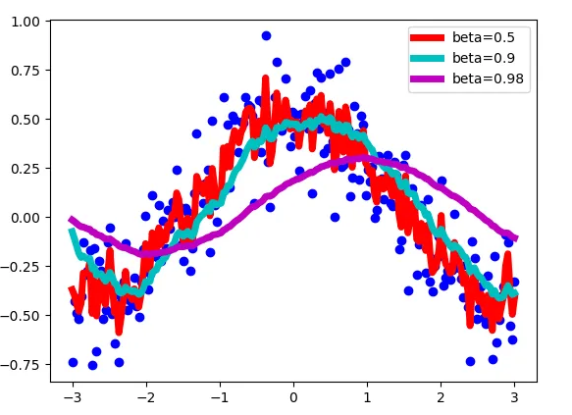

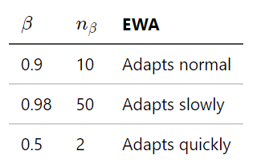
EWA
V_{t} = β ∗ (V_{t}−1)+(1−β) ∗ NewSample
n_{β} as the numbers of observations used to adapt your EWA.

Slide 30
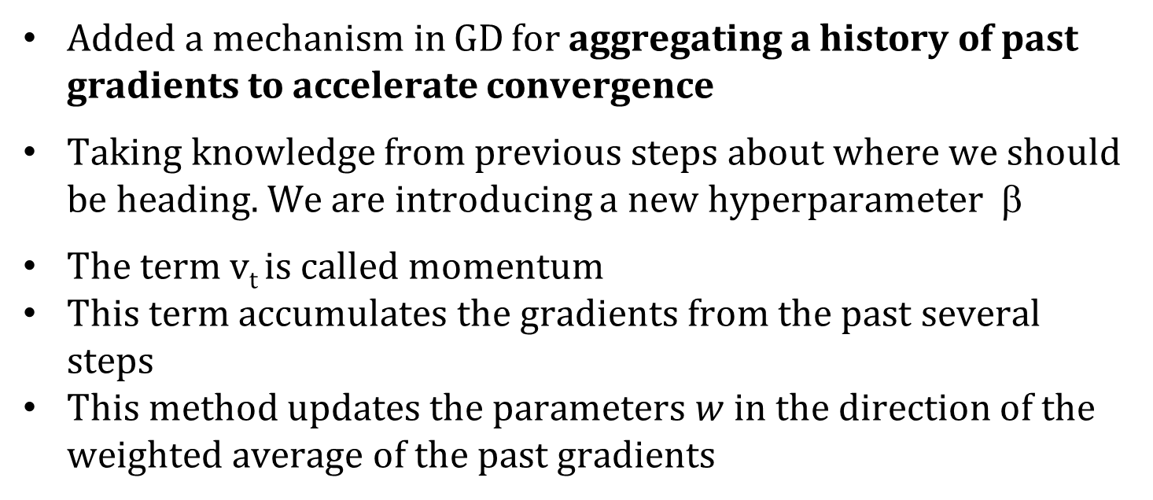
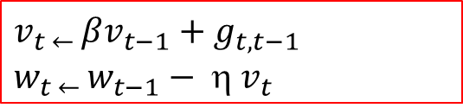
Gradient Descent with Momentum
V_{t} = β ∗ (V_{t}−1)+(1−β) ∗ NewSample
Added a mechanism in GD for aggregating a history of past gradients to accelerate convergence
Taking knowledge from previous steps about where we should be heading. We are introducing a new hyperparameter β
The term v_{t} is called momentum
This term accumulates the gradients from the past several steps
This method updates the parameters $w$ in the direction of the weighted average of the past gradients
$$v_{t ← }βv_{t−1}+{ g}_{t,t−1}$$
$$w_{t ← }w_{t−1}−  v_{t}$$

Slide 31
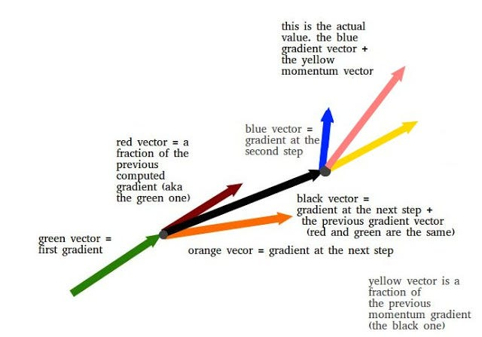
Gradient Descent with Momentum

Slide 32
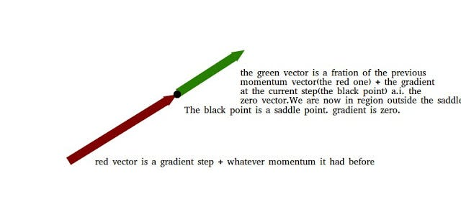
Gradient Descent with Momentum

Slide 33
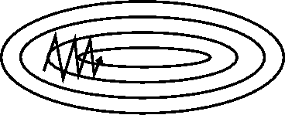
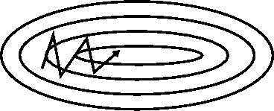
Momentum Update
Plain gradient update With momentum
Momentum averages out the oscillations
In a vertical direction, oscillations are reduced because positive and negative numbers average out, Reduces updates for dimensions whose gradients change directions
In a horizontal direction, the movement remains aggressive, which speeds up the descent, Increases updates for dimensions whose gradients point in the same directions.

Slide 34
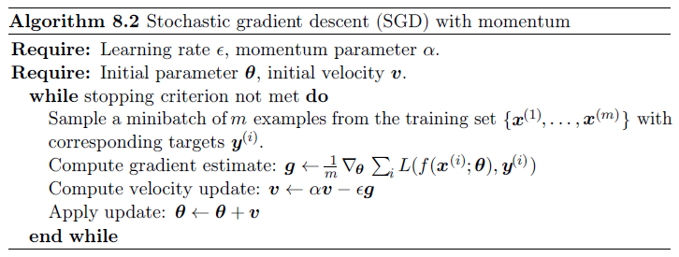
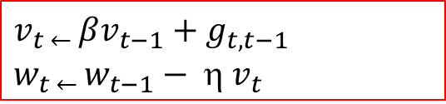
Gradient Descent with Momentum
$$v_{t ← }βv_{t−1}+{ g}_{t,t−1}$$
$$w_{t ← }w_{t−1}−  v_{t}$$

Slide 35
Gradient Descent with Momentum
Momentum replaces gradients with a leaky average over past gradients. This accelerates convergence significantly.
Momentum prevents stalling of the optimization process that is much more likely to occur for stochastic gradient descent.
The effective number of gradients is given by 1/ (1−β ) due to exponentiated downweighting of past data.
Implementation is quite straightforward but it requires us to store an additional state vector (momentum v).

Slide 36
Gradient Descent with Momentum
Gradient descent with momentum uses the momentum of the gradient for parameter optimization
cost $ℒ\left(θ\right)$
Movement = Negative of Gradient + Momentum
Negative of Gradient
Momentum
Real Movement
$$θ$$
Gradient = 0
Slide credit: Hung-yi Lee – Deep Learning Tutorial

Slide 37
Solved problem SGD and SGD + momentum
Consider the following loss function, with initial value of W^{{0}} = -2.8, and learning rate η = 0.05 and β=0.7. Use SGD and SGD +momentum to find the updated value of W^{{1}} after the first iteration.
Answer
SGD SGD +momentum
$$L(w)=0.3∗w^{4} −0.1∗ w^{3} −2∗w^{2} −0.8∗w$$
Iteration | 𝑔𝑖 | w𝑖
1 | -18.2943 | -1.88527
2 | -2.36614 | -1.76697
Iteration | 𝑔𝑖 | v𝑖 | w𝑖
1 | -18.294 | 0 | -1.88527
2 | -2.3661 | -15.172 | -1.126

Slide 39
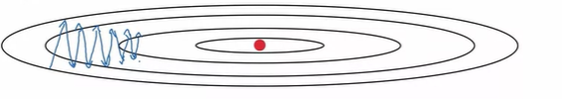
Adagrad - motivation
In GD same LR for all parameters and iteration.
What happens to features that occur infrequently (sparse features) e.g w is sparse, b is not (as x₀ is always 1) e.g:
Parameters associated with infrequent features only receive meaningful updates whenever these features occur
b
W

Slide 40
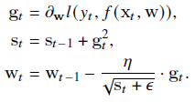
Adagrad
Decay the learning rate for parameters in proportion to their update history
An individual learning rate per parameter(feature)
Accumulating past squared gradients in s_{t}
ϵ is a smoothing term that avoids division by zero
Initialize s₀ = 0
Adagrad's main benefits is that it eliminates the need to manually tune the learning rate.
Most implementations use a default value of 0.01 and leave it at that
Application: In natural language processing and image recognition applications
_{Accumulate the history}

Slide 41
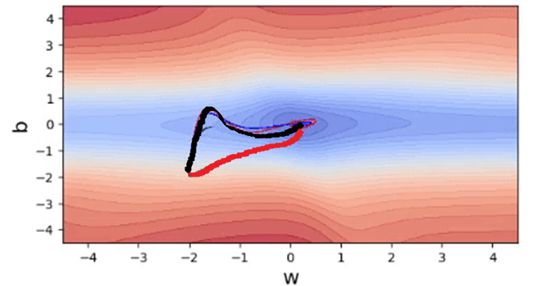
Adagrad
It adapts the learning rate to the parameters
  smaller updates (i.e. low learning rates) for parameters associated with frequently occurring features
  larger updates (i.e. high learning rates) for parameters associated with infrequent features

Slide 42

Drawback of AdaGrad
AdaGrad decays the learning rate very aggressively (as the denominator grows).
As a result, after a while, the frequent parameters will start receiving very small updates because of the decayed learning rate.
As a result, the algorithm may experience sluggish convergence or even premature stalling
To avoid this why not decay the denominator and prevent its rapid growth

Slide 43

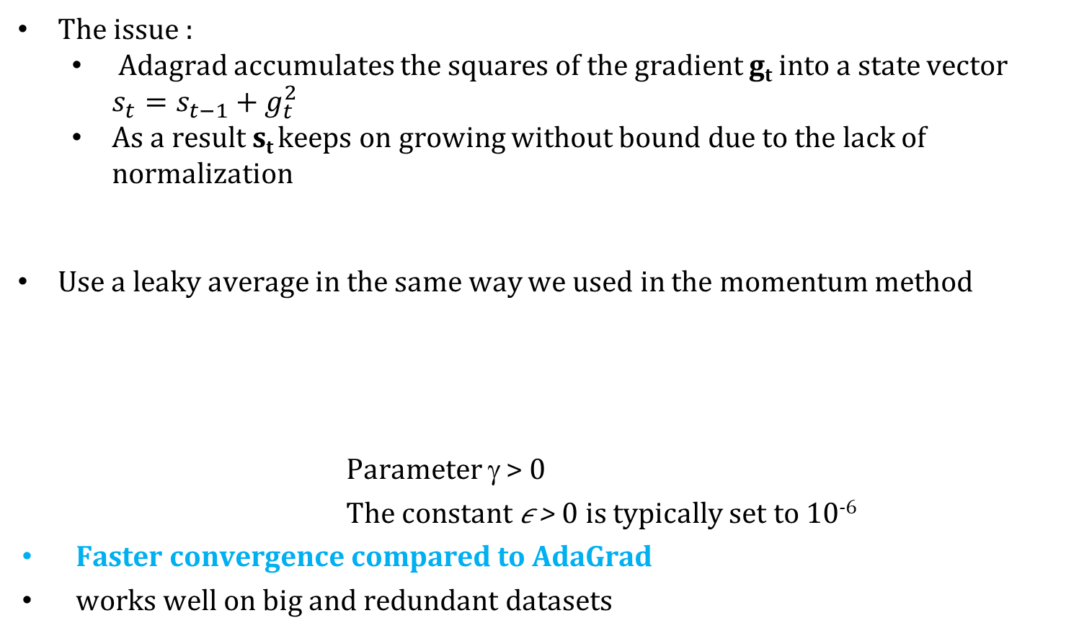
RMSProp
The issue :
  Adagrad accumulates the squares of the gradient g_{t} into a state vector $s_{t}=s_{t−1}+g_{t}^{2}$
  As a result s_{t} keeps on growing without bound due to the lack of normalization
Use a leaky average in the same way we used in the momentum method
            Parameter γ > 0
            The constant 𝜖 > 0 is typically set to 10⁻⁶
Faster convergence compared to AdaGrad
works well on big and redundant datasets

Slide 44
Review of techniques learned so far
Stochastic gradient descent
  more compute effective than Gradient Descent when solving optimization problems
  Mini batch Stochastic gradient descent affords significant additional efficiency arising from vectorization, using larger sets of observations in one mini batch.
  This is the key to efficient multi-machine,multi-GPU and overall parallel processing.
Momentum
  added a mechanism for aggregating a history of past gradients to accelerate convergence.
Adagrad
  used per-coordinate scaling to allow for a computationally efficient preconditioner.
RMSProp
  leaky average + dynamic learning rate

Slide 45

Adam-Adaptive Moment Estimation
Adam combines all these techniques into one efficient learning algorithm.
computes individual adaptive learning rates for different parameters from estimates of the first and second moments of the gradients.
utilize the momentum concept from “SGD with momentum” and adaptive learning rate from “RMSProp”
Adam can diverge due to poor variance control. (disadvantage)
← V for Momentum
← S for RMSProp

Slide 46



Adam Algorithm
β₁ and β₂ are nonnegative weighting parameters.
Common choices for them are β₁ = 0.9 and β₂ = 0.999.
Initialize v0 = s0 = 0
Normalize the state variables (bias correction)→
Bias-correction helps Adam slightly outperform RMSprop
Rescale the gradient →
Compute updates →
first moment (the mean)of gradient
←second moment (uncentered variance) of gradients

Slide 47



Optimization algorithm comparison
Gradient Descent
$$w_{t ← }w_{t−1}−  g_{t}$$
GD with Momentum: replaces gradients
with a leaky average over past gradients
$$v_{t ← }βv_{t−1}+{ g}_{t,t−1}$$
$$w_{t ← }w_{t−1}−  v_{t}$$
AdaGrad (Adaptive learning rate): An
individual learning rate per parameter
RMSProp : exponentially decaying
average of past squared gradients
Adam : exponentially decaying average of past
gradients + exponentially decaying average of
past squared gradients

Slide 48
ADAM VS SGD
Adaptive methods (such as Adam) do not generalize as well as SGD with momentum when tested on a diverse set of deep learning tasks
In the research paper by Nitish Shirish Keskar, Richard Socher : Improving Generalization Performance by Switching from Adam to SGD :
Earlier stages of training Adam still outperforms SGD but later the learning saturates. They proposed simple strategy in which they start training deep neural network with Adam but then switch to SGD when certain criteria hits

Slide 49
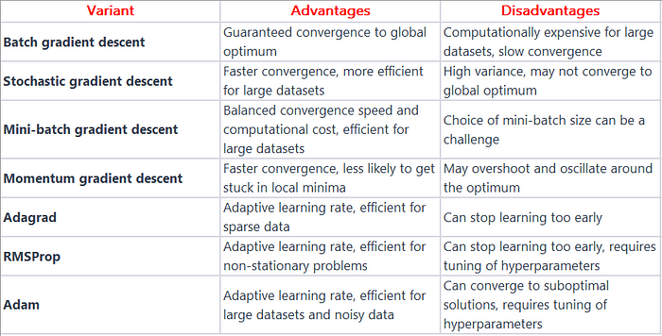
Optimization algorithm comparison

Slide 50
References
Chapter – 12 Dive into Deep Learning
https://d2l.ai/

Slide 51
Thank You All !

